Slide 1

Team Details
Team name: Alpha
Team leader name: Muthu Shree MC
Problem Statement: "Build an AI-powered, context-aware chatbot that delivers personalized, meaningful interactions and integrates seamlessly with the JobsForHer Foundation platform to empower women’s professional journeys."

Slide 2
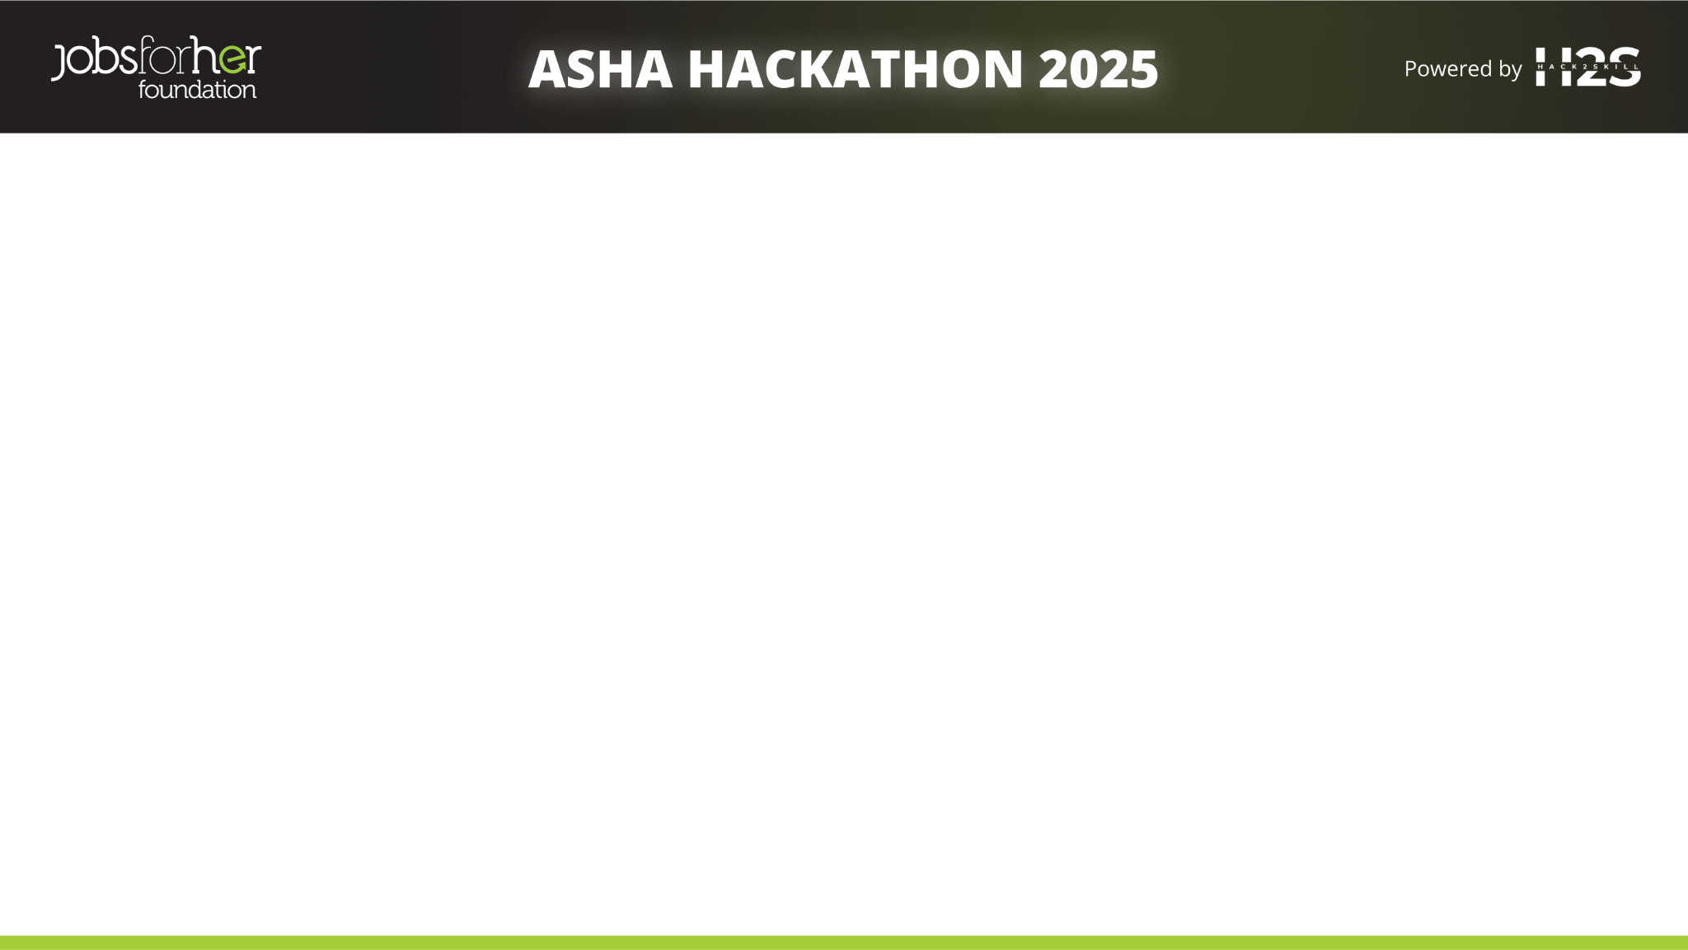
Brief about the idea
Empowering Women: Asha AI Chatbot helps women explore job opportunities, events, and mentorship programs easily.
Real-time Information: It fetches latest job listings, upcoming community events, and mentor profiles dynamically through public APIs.
Retrieval-Augmented Generation (RAG): Combines live knowledge retrieval with AI reasoning for accurate and contextual responses.
Bias-Free, Ethical AI: Detects and mitigates gender bias, ensuring inclusive, supportive, and respectful conversations.
Personalized Assistance: Supports multi-turn conversations, delivering context-aware career guidance tailored to user needs.
Seamless Integration: Built using React (frontend), Flask (backend), Pinecone (vector DB), and Groq API for fast, scalable responses.

Slide 3
Opportunities
How different is it from any of the other existing ideas?
Unlike traditional chatbots that rely only on static FAQ-based responses, Asha AI Chatbot uses dynamic Retrieval-Augmented Generation (RAG) and live public APIs to provide up-to-date job listings,mentorship data, and event information. It ensures inclusivity by detecting and correcting gender bias in real-time.
How will it be able to solve the problem?
Asha AI Chatbot empowers women by simplifying access to career opportunities through intelligent, real-time guidance. It helps bridge the information gap by offering relevant jobs, events, and mentorship connections tailored specifically for women's career growth.
USP of the proposed solution?
✅ Context-aware, multi-turn conversations ✅ Ethical AI focused on bias mitigation
✅ Real-time knowledge base updates from verified APIs ✅ Built specifically for empowering women professionals
✅ Seamless integration of RAG + LLM (Groq API) + Pinecone for accurate and fast responses

Slide 4
List of features offered by the solution
Real-Time Job & Mentorship Search
➔ Instantly fetches latest job openings, mentorship opportunities, and events for women from public APIs.
Retrieval-Augmented Generation (RAG) Technology
➔ Combines live data retrieval with Groq-powered LLMs to deliver contextually accurate and personalized answers.Bias-Free and Inclusive AI➔ Detects and corrects gender bias, ensuring positive, respectful, and empowering interactions.
Context-Aware Multi-Turn Conversations
➔ Supports continuous dialogue by remembering the conversation flow for better guidance.
Secure, Scalable, and Privacy-First
➔ Built with Flask, Pinecone, and Groq ensuring fast, scalable responses while maintaining strict privacy.

Slide 5
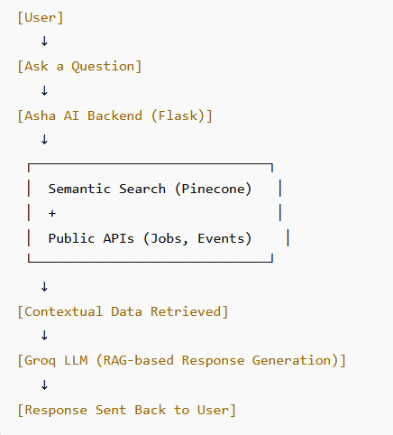
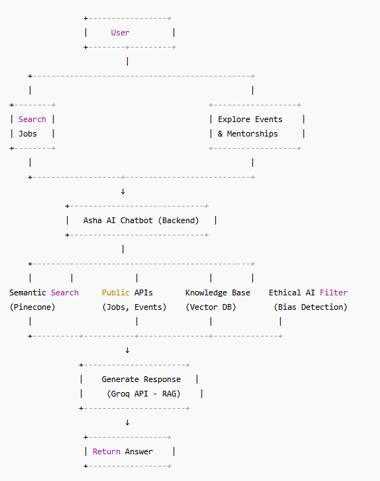
Process flow diagram or Use-case diagram

Slide 6
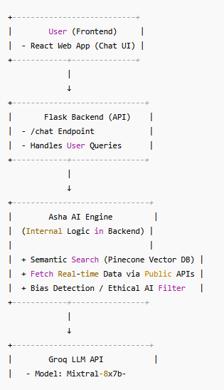
Architecture diagram of the proposed solution

Slide 7
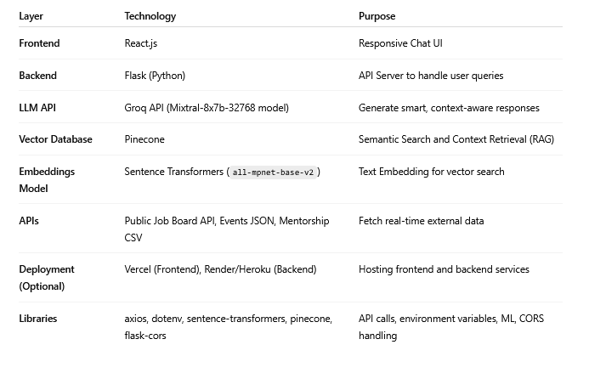
Technologies to be used in the solution

Slide 8
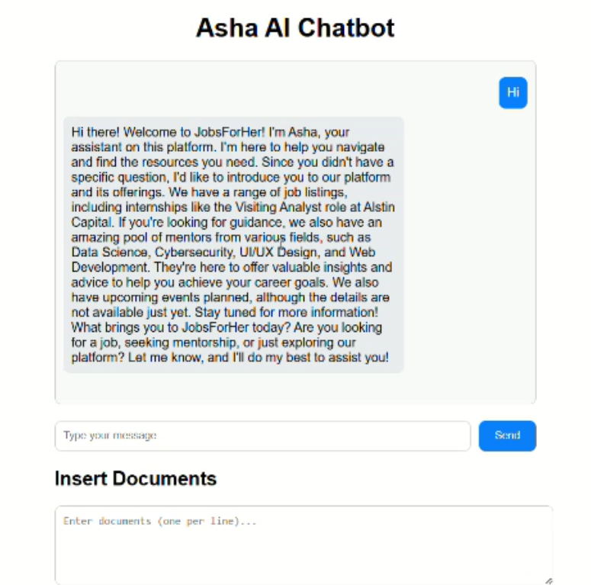
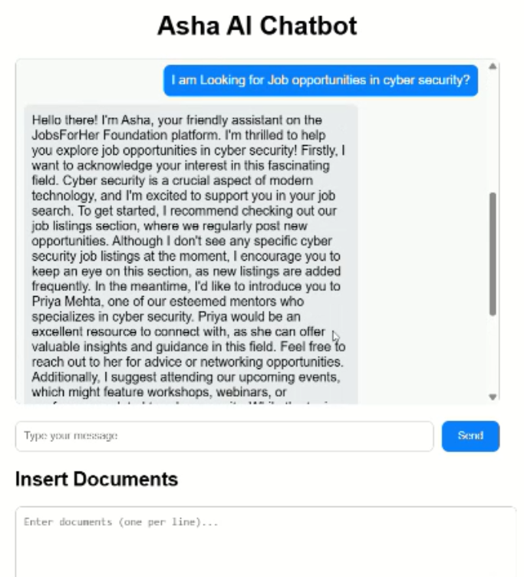
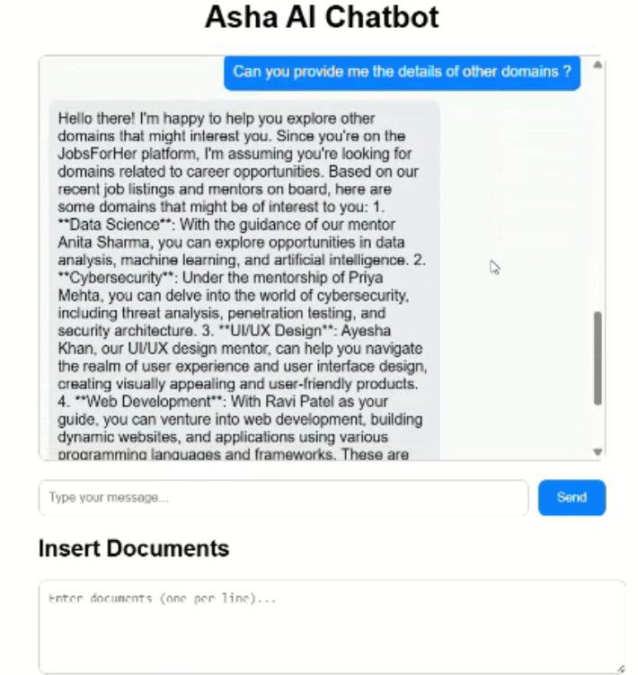
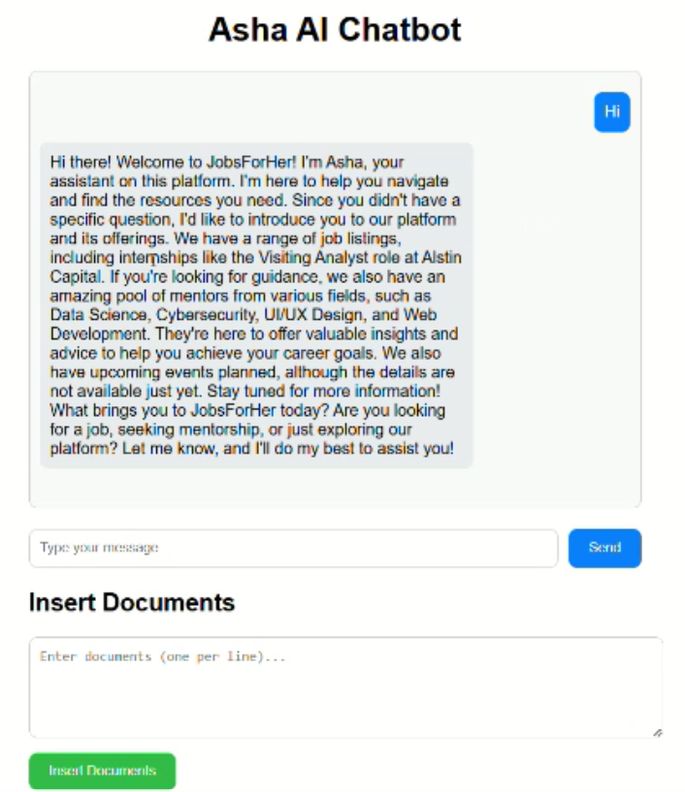
Snapshots of the prototype
Detailed intro
Here you can upload your
resume or job description details.
Response for user question

Slide 9
Source Code Repository:
Access to the complete source code, preferably hosted on a platform like GitHub, with clear documentation
Github Repository link :https://github.com/kavya-ux-2/Asha_ai_bot

Slide 10
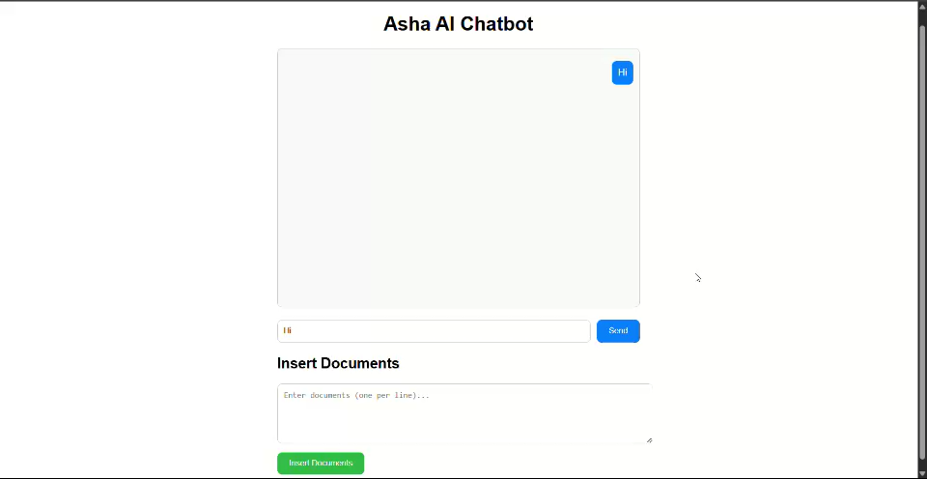
Demo Video:
A short video (3-5 minutes) demonstrating the chatbot functionalities, user interactions, and key features.

Slide 11


